Slide 1

Virtual Shopping Backend Project
TanTTN, NghiaPM1, AungPMM, MinhLD15

Slide 2
Introduction:
Project Supervisors:
Le Pham Quoc Hung
Le Van Linh
Developers:
Ton That Nhat Tan: tanttn@fsoft.com.vn
Le Duc Minh: minhld15@fsoft.com.vn
Pham Minh Nghia: nghiapm1@fsoft.com.vn
Phyo Mie Mie Aung: aungpmm@fsoft.com.vn

Slide 3




How it works
Host creates a shopping cart
Guests invited to co-make order
Shop confirms order
Shop notify order status to host/guest
Guests can add/remove items before submitted
Submit
Submit

Slide 4
Live Updates
Confirmed
Send to Kitchen
Ready to Delivery / Ready to Pickup
Completed
Our application allows shops and users to receive live notifications whenever carts or orders are modified
Update
Notify
Co-maker
Cancelled
Change order status
Notify
Co-maker
Co-maker

Slide 5







Tech stack used
For this project, we used Microsoft ASP.NET to build API endpoints
For live updates, we used SignalR to send notifications
To test API endpoint functionality, we used Swagger UI or Postman
For the front end, we used Angular JS, React JS
For the Database, we used SQL and SSMS

Slide 6
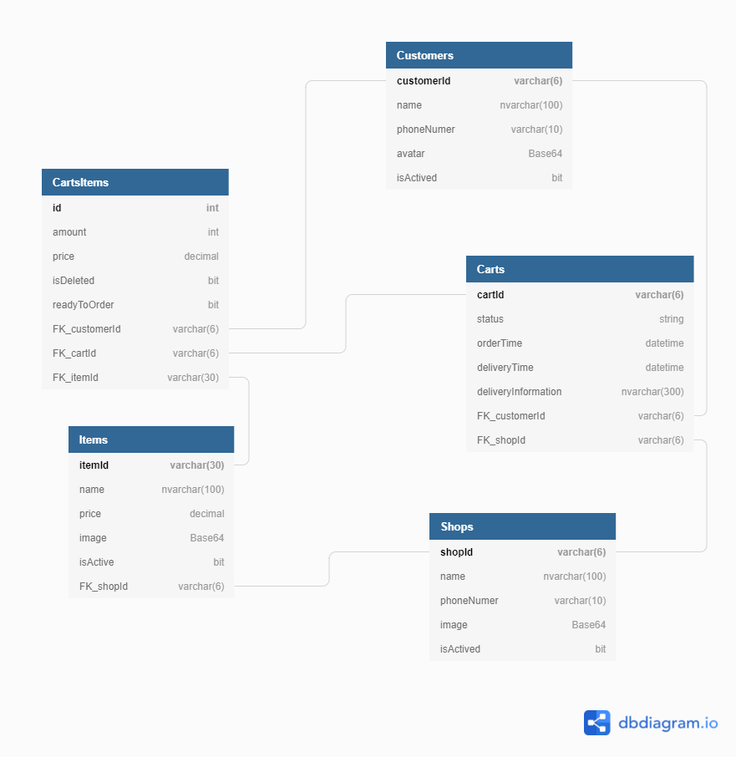
APIs and System Design

Slide 7
Project Structure
http:project/api/cart/get
Controller (API)
Three Layers Architecture:
Presentation Layer (API)
Business Logic Layer (BLL)
Data Layer (DAL)
Benefits:
Distinct infrastructure in each layers allows for continuous and simultaneous development
Each layers can be updated and scaled independently
Cart Services (BLL)
Cart Repository
DAL
Unit Of Work
DB Context
SQL Database

Slide 8
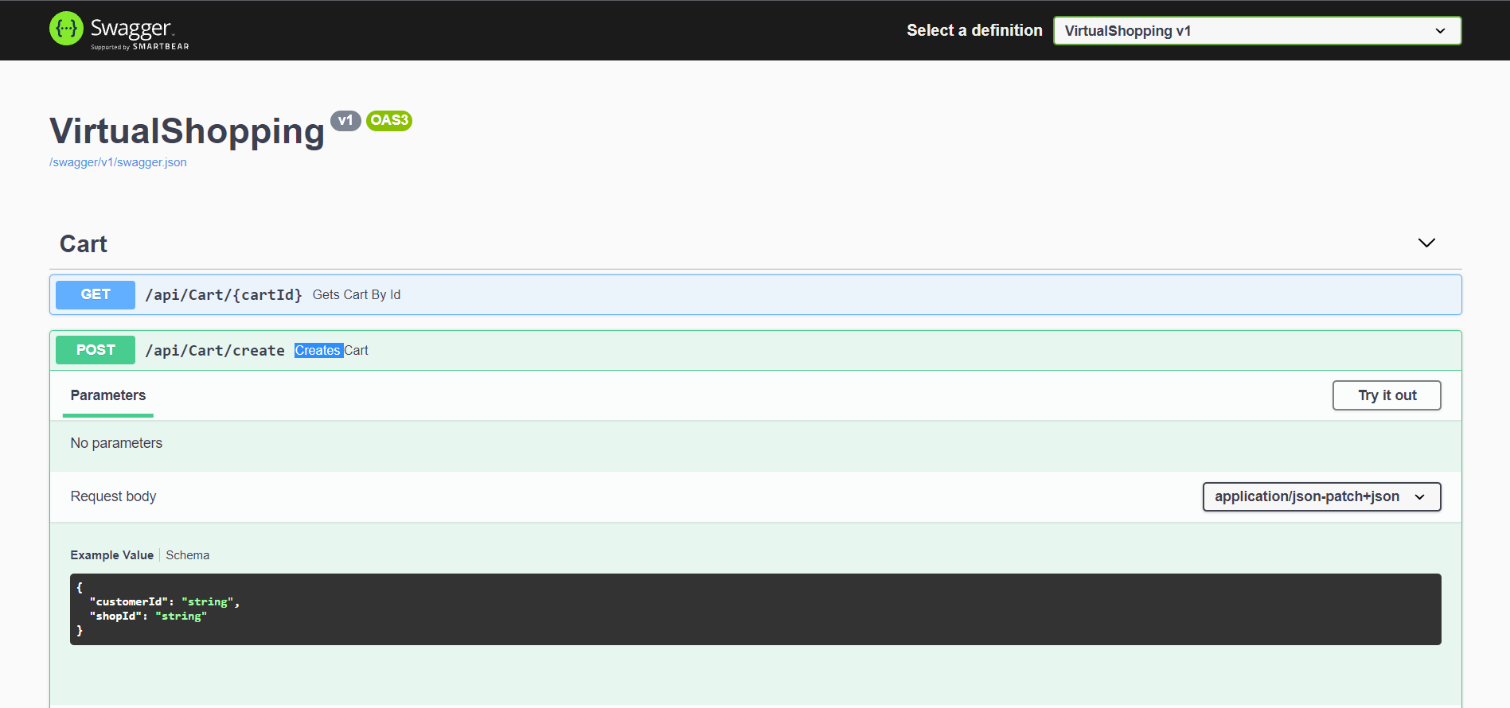
Swagger
Powerful API documentation tool
Also allows endpoints testing

Slide 9
Frontend Mockup (Angular) - DEMO
To be updated
Find and download on Workplace group

Slide 10
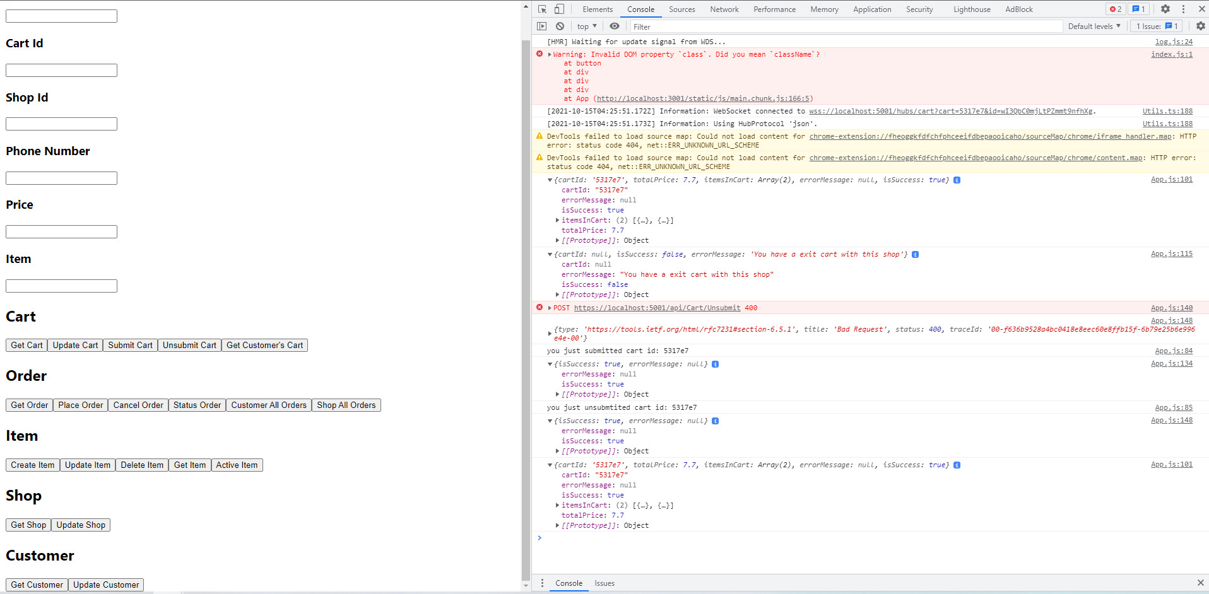
Frontend Mockup (ReactJs)
To be updated
Find and download on Workplace group

Slide 11
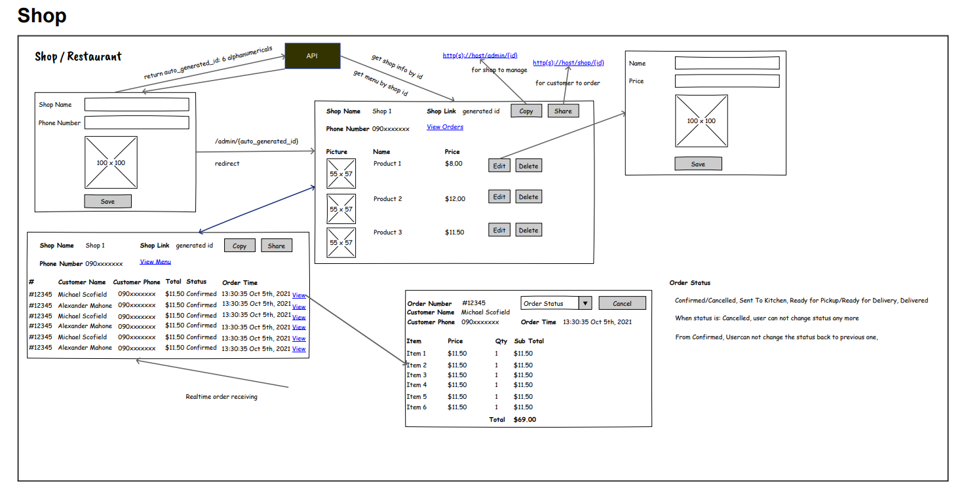
Fronted Design (shop)

Slide 12
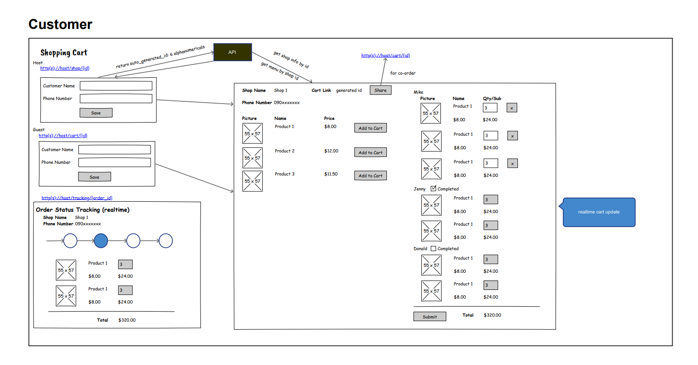
Frontend Design (Customer)

Slide 13

Bugs!!!
Needs support or Report bugs find us on Workplace
https://fpt.workplace.com/groups/560826411868973

Slide 14
Frontend Project Assessment Criteria
HungLPQ

Slide 15
Thank you
Thank you and Good luck

